Slide 1
Non-Valued Graphs in Social Networks

Slide 2
Do the edges of the graph have a value attached to them?
No
Yes
Non-Valued Graph
Valued Graph
Do the edges have a direction?
Can the edge values be any number or only -1 or + 1?
No
Yes
Any
+1/-1
Do the edges have a direction?
Do the edges have a direction?
Undirected graph
Is the direction two-way or only one-way?
No
2-Way
Undirected Weighted Graph
Yes
No
Yes
Directed Graph
1-Way
Directed Weighted Graph
Tree Graph
Undirected Signed Graph
Directed Signed Graph

Slide 3
Non-Valued Graphs in Social Networks
Non-Valued Graph
In social network analysis non-valued graphs represent the presence or absence of social relations
Do the edges have a direction?
No
Yes
Undirected graph
Is the direction two-way or only one-way?
2-Way
Directed Graph
1-Way
Tree Graph

Slide 4
Non-Valued Graphs in Social Networks
Non-Valued Graph
In social network analysis non-valued graphs represent the presence or absence of social relations
  Either a relation is there or not!
Do the edges have a direction?
No
Yes
Undirected graph
Is the direction two-way or only one-way?
2-Way
Directed Graph
1-Way
Tree Graph

Slide 5
Non-Valued Graphs in Social Networks
Non-Valued Graph
In social network analysis non-valued graphs represent the presence or absence of social relations
  Either a relation is there or not!
The only thing we know is whether there is directionality to the social relationship
  Two options:
Do the edges have a direction?
No
Yes
Undirected graph
Is the direction two-way or only one-way?
2-Way
Directed Graph
1-Way
Tree Graph

Slide 6
Non-Valued Graphs in Social Networks
Non-Valued Graph
In social network analysis non-valued graphs represent the presence or absence of social relations
  Either a relation is there or not!
The only thing we know is whether there is directionality to the social relationship
  Two options:
    Directionality is meaningful to characterizing the tie
Do the edges have a direction?
No
Yes
Undirected graph
Is the direction two-way or only one-way?
2-Way
Directed Graph
1-Way
Tree Graph

Slide 7
Non-Valued Graphs in Social Networks
Non-Valued Graph
In social network analysis non-valued graphs represent the presence or absence of social relations
  Either a relation is there or not!
The only thing we know is whether there is directionality to the social relationship
  Two options:
    Directionality is meaningful to characterizing the tie
    Directionality is meaningless
Do the edges have a direction?
No
Yes
Undirected graph
Is the direction two-way or only one-way?
2-Way
Directed Graph
1-Way
Tree Graph

Slide 8
Types of Edges in Graphs

Slide 9
Types of Edges in Graphs
Symmetric
  If A is linked to B, then B is necessarily linked to A
A
B
Symmetric Edge

Slide 10
Types of Edges in Graphs
Symmetric
  If A is linked to B, then B is necessarily linked to A
Asymmetric
  If A is linked to B, it is not a necessary that B is linked to A (but can happen)
A
B
Symmetric Edge
A
B
Asymmetric Edge

Slide 11
Types of Edges in Graphs
Symmetric
  If A is linked to B, then B is necessarily linked to A
Asymmetric
  If A is linked to B, it is not a necessary that B is linked to A (but can happen)
Antisymmetric
  If it exists then is A is linked to B, then B cannot by necessity be linked to A
A
B
Symmetric Edge
A
B
Asymmetric Edge
A
B
Antisymmetric Edge

Slide 12
Types of Edges in Graphs
Symmetric
  If A is linked to B, then B is necessarily linked to A
Asymmetric
  If A is linked to B, it is not a necessary that B is linked to A (but can happen)
Antisymmetric
  If it exists then is A is linked to B, then B cannot by necessity be linked to A
A
B
No Directionality
A
B
Two-Way Directionality
A
B
One-Way Directionality

Slide 13
Types of Edges in Graphs
Asymmetric edges can be of two kinds:
  Reciprocal: If edges going in both directions exist
    You like me and I like you
    You help me and I help you
  Nonreciprocal: Edges only go in one direction
    You don’t like me, but I like you
    You help me, but I don’t help you
  Reciprocity is only defined for asymmetric edges!
A
B
Reciprocal Edge
A
B
Nonreciprocal Edge

Slide 14
Types of Edges in Graphs
Edges
Symmetric
Asymmetric
Antisymmetric
Reciprocal
Nonreciprocal

Slide 15
Types of Edges and Types of Non-Valued Graphs
Non-Valued Graph
Do the edges have a direction?
No
Yes
Undirected graph
Is the direction two-way or only one-way?
2-Way
Directed Graph
1-Way
Tree Graph

Slide 16
Types of Edges and Types of Non-Valued Graphs
Non-Valued Graph
A
B
Do the edges have a direction?
Symmetric Edge
No
Yes
Undirected graph
Is the direction two-way or only one-way?
2-Way
Directed Graph
1-Way
Tree Graph

Slide 17
Types of Edges and Types of Non-Valued Graphs
Non-Valued Graph
A
B
Do the edges have a direction?
Symmetric Edge
A
B
No
Yes
Undirected graph
Is the direction two-way or only one-way?
Asymmetric Edge
2-Way
Directed Graph
1-Way
Tree Graph

Slide 18
Types of Edges and Types of Non-Valued Graphs
Non-Valued Graph
A
B
Do the edges have a direction?
Symmetric Edge
A
B
No
Yes
Undirected graph
Is the direction two-way or only one-way?
Asymmetric Edge
2-Way
A
B
Directed Graph
1-Way
Tree Graph
Antisymmetric Edge

Slide 19
Types of Edges and Types of Non-Valued Graphs
Non-Valued Graph
A
B
Do the edges have a direction?
Symmetric Edge
A
B
No
Yes
Undirected graph
Is the direction two-way or only one-way?
Asymmetric Edge
2-Way
A
B
Directed Graph
1-Way
Tree Graph
Antisymmetric Edge

Slide 20
Types of Ties in Social Networks

Slide 21
Types of Social Network Connectivity
How do you build a social network?

Slide 22
Types of Social Network Connectivity
How do you build a social network?
  You begin with a set of actors
    A, B, C, D
A
B
C
D

Slide 23
Types of Social Network Connectivity
How do you build a social network?
  You begin with a set of actors
    A, B, C, D
  And you place links between connected pairs!
A
B
Connected
C
D

Slide 24
Types of Social Network Connectivity
How do you build a social network?
  You begin with a set of actors
    A, B, C, D
  And you place links between connected pairs!
But how do you decide if two actors are connected?
A
B
Connected
C
D

Slide 25
Types of Social Network Connectivity
How do you build a social network?
  You begin with a set of actors
    A, B, C, D
  And you place links between connected pairs!
But how do you decide if two actors are connected?
  Social networks analysts use three criteria:
    Are the actors similar in some respect?
    Do the actors interact in some manner?
    Do the actors play complementary roles?
A
B
Connected
C
D

Slide 26
Types of Social Network Connectivity
Similarities: Link people who have something in common
  Co-location
  Co-membership
  Same trait, identity, or social category
Interactions: Link people who behave in certain ways toward one another
  Texting, calling, zooming
  Helping, advising, ask out on a date
  Liking, disliking, fighting, bullying
Role-relations: Link people who recognize one another using a culturally recognized label
  Kin ties (parent of, sibling of, cousin of, uncle of)
  Informal non-kin ties (friends, neighbors, acquaintances)
  Formal non-kin ties (co-workers, boss of, supervisor of)

Slide 27
Types of Social Network Connectivity
Similarities: Link people who have something in common
  Co-location
  Co-membership
  Same trait, identity, or social category
Interactions: Link people who behave in certain ways toward one another
  Texting, calling, zoom invite
  Helping, advising, ask out on a date
  Liking, disliking, fighting, bullying
Role-relations: Link people who recognize one another using a culturally recognized label
  Kin ties (parent of, sibling of, cousin of, uncle of)
  Informal non-kin ties (friends, neighbors, acquaintances)
  Formal non-kin ties (co-workers, boss of, supervisor of)

Slide 28
Types of Social Connectivity
Similarities: Link people who have something in common
  Co-location
  Co-membership
  Same trait, identity, or social category
Interactions: Link people who behave in certain ways toward one another
  Texting, calling, zooming
  Helping, advising, ask out on a date
  Liking, disliking, fighting, bullying
Role-relations: Link people who recognize one another using a culturally recognized label
  Kin ties (parent of, sibling of, cousin of, uncle of)
  Informal non-kin ties (friends, neighbors, acquaintances)
  Formal non-kin ties (co-workers, boss of, supervisor of)

Slide 29


Types of Ties in Networks
There are systematic commonalities between the ways we link people in network and the three different types of ties!
  Similarities are necessarily symmetric
    If you are in the same place at the same time as another person, then they are also in the same place at the same time with you!
    If you are zooming with someone, then they are also zooming with you!
    If you go to UCLA with someone, then they also go to UCLA with you!
  Interactions are necessarily asymmetric
    You can like someone, but they don’t have to like you back!
    You can send a text to someone, but they don’t have to respond!
    You can follow someone on Twitter, but they don’t have to follow you back!
Similarities
Interactions

Slide 30
Types of Ties in Networks
There are systematic commonalities between the ways we link people in network and the three different types of ties!
  Similarities are necessarily symmetric
    If you are in the same place at the same time as another person, then they are also in the same place at the same time with you!
    If you are zooming with someone, then they are also zooming with you!
    If you go to UCLA with someone, then they also go to UCLA with you!
  Interactions are necessarily asymmetric
    You can like someone, but they don’t have to like you back!
    You can send a text to someone, but they don’t have to respond!
    You can follow someone on Twitter, but they don’t have to follow you back!
Similarities
Interactions

Slide 31
Types of Ties in Networks
There are systematic commonalities between the ways we link people in network and the three different types of ties!
  Similarities are necessarily symmetric
    If you are in the same place at the same time as another person, then they are also in the same place at the same time with you!
    If you are zooming with someone, then they are also zooming with you!
    If you go to UCLA with someone, then they also go to UCLA with you!
  Interactions are necessarily asymmetric
    This means that interactions can be either:
      Reciprocal
      Non-Reciprocal
Similarities
A
B
Reciprocal Edge
A
B
Interactions
Nonreciprocal Edge

Slide 32


Types of Ties in Networks
There are systematic commonalities between the ways we link people in network and the three different types of ties!
  Role Relations can be either antisymmetric or symmetric but can’t be asymmetric:

Slide 33
Types of Ties in Networks
There are systematic commonalities between the ways we link people in network and the three different types of ties!
  Role Relations can be either antisymmetric or symmetric but can’t be asymmetric:
    Antisymmetric role relations
      Kin
        If you are someone’s parent, they can’t be your parent back!
      Formal non-kin:
        If you are someone’s boss, they can’t be your boss at the same time!

Slide 34
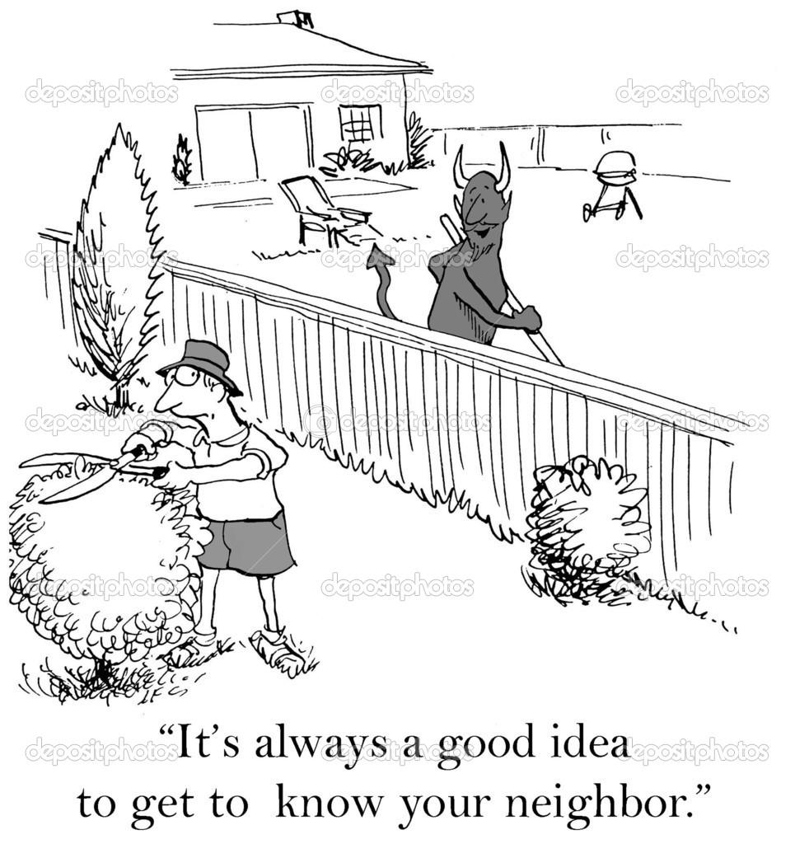

Types of Ties in Networks
There are systematic commonalities between the ways we link people in network and the three different types of ties!
  Role Relations can be either antisymmetric or symmetric but can’t be asymmetric:
    Symmetric role relations
      Kin
        If you are someone’s sibling, they are also your sibling!
      Informal non-kin:
        If you are someone’s neighbor, they are also your neighbor!
      Formal non-kin
        If you are someone’s co-worker, they are also your co-worker!

Slide 35
Summary: Types of Ties, Edges, and Graphs
Non-Valued Graph
Do the edges have a direction?
Similarities
A
B
No
Yes
Symmetric Edge
Undirected graph
Is the direction two-way or only one-way?
Interactions
A
B
2-Way
Asymmetric Edge
Directed Graph
1-Way
Roles
A
B
Tree Graph
Antisymmetric Edge

Slide 36
Undirected Graphs
This is a simple graph
  A graph is a simple graph if:
    There is only one edge joining adjacent nodes
      No multiedges
    There are no self-edges
      No loops
    Edges lack directionality
      No “arrows”
    Edges don’t have any properties
      Weights, signs, etc.
C
B
E
A
D

